Slide 1

Building and manage innovative Web apps powered by containers using the Microsoft Developer stack
Maheshkumar R
Senior Tech Evangelist (Azure), Microsoft
Certified Azure Solution Architect & The Linux Foundation Certified CKAD & LFCS
MahesKBlr

Slide 2
Agenda
What is Containers
An overview on the importance of Containers and how your business and customers will benefit
Benefits of using Containers
What it does, what you can use it for, and why you should use it.
Journey to the cloud
Build new functionality that your users will love
Containers on Azure
Overview of containers in Azure
Migration
Tools and migration service
Demo
Demo showcasing Azure App Service (Containers), AKS (Containers) and ACI (Containers)

Slide 3
The traditional tenants of hosting
Choose the right balance of control and responsibility based on your needs
Responsibility
On-prem
IaaS
PaaS
SaaS
Build from the ground up
Some assembly required
Move-in ready
Applications
Data
Runtime
Middleware
Operating system
Virtualization
Servers
Storage
Networking
Customer
Microsoft

Slide 4
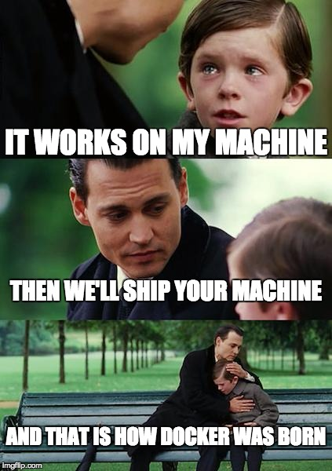
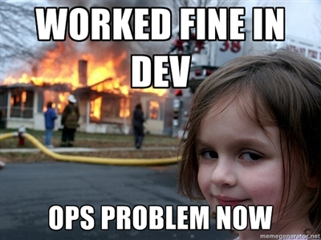

Slide 5
Cloud application hosting continuum
IaaS
Infrastructure Platform
CaaS
Container Platform
PaaS
Application Platform
FaaS
Serverless Platform
Challenges
Patching, Management, Deployment
Management (Container & Pod)
Limitations of Execution environment
Cold start, long running process
What you get
Curated VM Hosting
Curated Orchestration
Curated Execution Environment
Scale to ‘zero’
Technology decisions
IT/Infra focused Value Prop
Dev/App Admin focused Value Prop
More Control of execution environment
Less Control of execution environment
Less Agile development & deployment
More Agile development & deployment

Slide 6
Cloud app continuum
SaaS apps
Serverless
Replace
Microservices
Rebuild New
Engineering Complexity and Cost
Containers
Rearchitect
VMs
Refactor
Existing on-premises applications
Rehost
App Modernization
Agility – Time to Market – Total Cost of Ownership – IT Simplification

Slide 7
The benefits of using containers
Agility
Ship apps faster
Portability
Easily move workloads
Density
Achieve resource efficiency
Rapid scale
Scale easily to meet demand

Slide 8
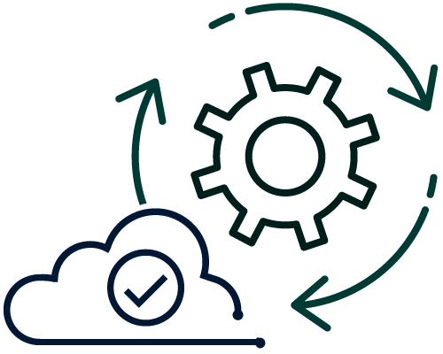
From traditional systems to portfolio of modern apps
App
Container
App
Existing/New Applications
Containerize Applications
Each host often runs 8 containers at a time¹
Microservices
Seconds to deploy, churns 12x faster¹
Continuous innovation with DevOps
46x more frequent for code delivery²
Source:
1: Datadog Report: 8 Surprising Facts About Real Docker Adoption; 2: 2018 state of DevOps Report

Slide 9

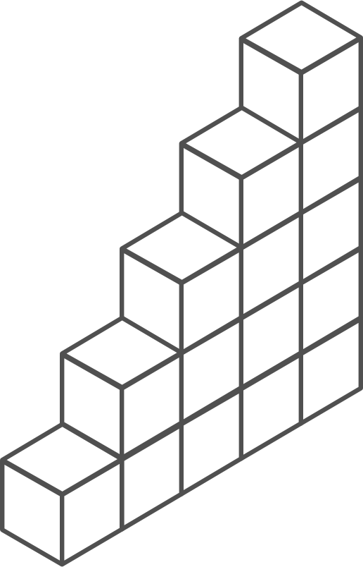
Containers momentum
“By 2020, more than 50% of enterprises will run mission-critical, containerized cloud-native applications in production.”
Half of container environment is orchestrated.¹
77%
77% of companies² who use container orchestrators choose Kubernetes.
The average size of a container deployment has grown 75% in one year. ¹
Larger companies are leading the adoption.¹
75%
50%
Nearly 50% of organizations¹ running 1000 or more hosts have adopted containers.
¹ Datadog report: 8 Surprising Facts About Real Docker Adoption
² CNCF survey: cloud-native-technologies-scaling-production-applications

Slide 10
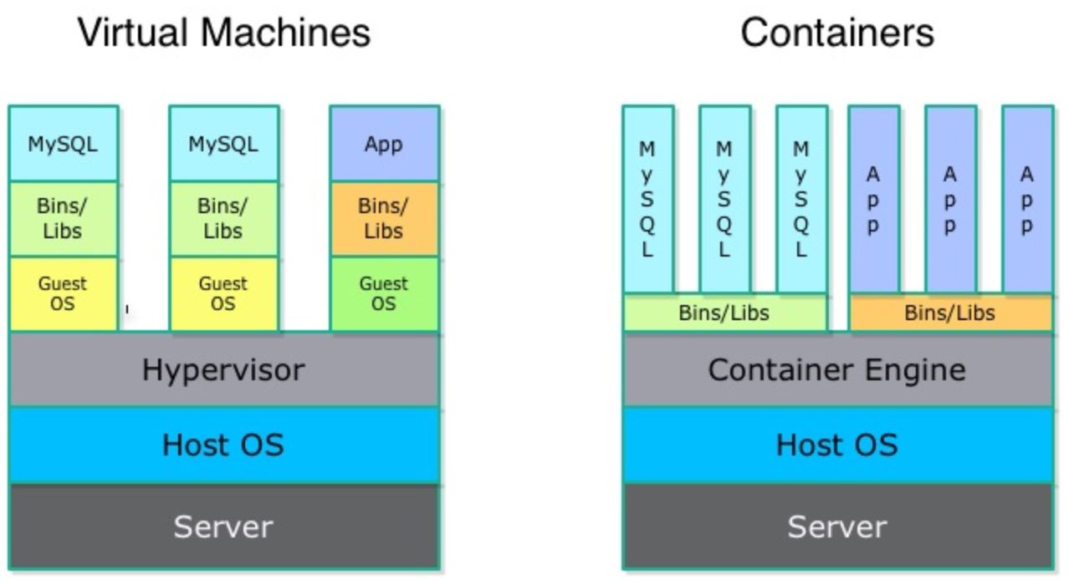
What is a container?

Slide 11


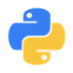

The benefits of using containers
Any OS
Anywhere
Any app
Any language
Java
Linux
On-premises
Monolith
.Net
Python
Windows
Cloud
Microservice
Node

Slide 12
The container advantage
Traditional virtualized environment
VM
VM
Low utilization of container resources
Containerization of applications and their dependencies for portability
Application
Con.
Con.
Application
Con.
Con.
From dev to production agility across development and operations teams
Hypervisor 2
Host OS
Hardware

Slide 13
The container advantage
Containerized environment
Migrate containers and their dependencies to underutilized VMs for improved density and isolation
VM
VM
Con.
Con.
Decommission unused resources for efficiency gains and cost savings
Con.
Con.
Container is lighter weight and faster to scale dynamically
Docker Engine
Host OS
Hardware

Slide 14
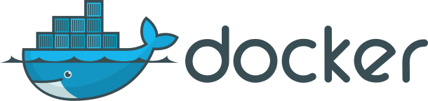
What is ?
An open source container runtime Mac, Windows and Linux support
# The world’s simplest Dockerfile
$ cat Dockerfile
FROM scratch
COPY hello /
CMD ["/hello"]
# Let’s create a docker image “tagged” hello-world
$ docker build –t hello-world .
# And run it…
$ docker run hello-world
* Dockers ** Kubernetes (HBD)

Slide 15

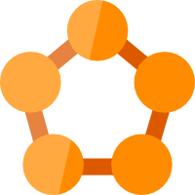

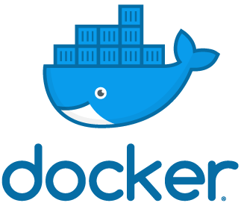




Containers in Azure
App Service
Service Fabric
Kubernetes Service
Container Instance
Ecosystem
Deploy web apps or APIs using containers in a PaaS environment
Modernize .NET applications to microservices using Windows Server containers
Scale and orchestrate Linux containers using Kubernetes
Elastically burst from your Azure Kubernetes Service (AKS) cluster
Bring your Partner solutions that run great on Azure
Azure Container Registry
Docker Hub
Choice of developer tools and clients

Slide 16
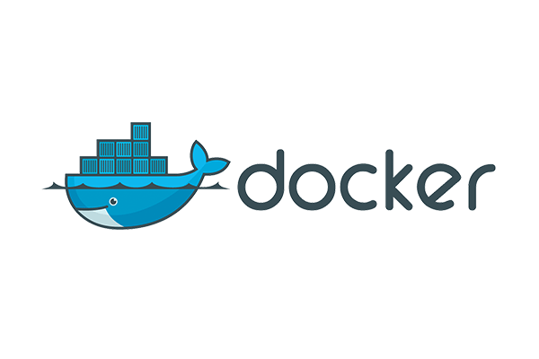



If you have a preferred container platform Pivotal Cloud Foundry  Kubernetes  Docker Enterprise Edition Red Hat OpenShift  Mesosphere DC/OS
Flexibility
Productivity
Trust
Pivotal Cloud Foundry
Self-managed Kubernetes
Docker Enterprise Edition
Red Hat OpenShift
Mesosphere DC/OS
You could bring that platform to Azure

Slide 17
The elements of orchestration
Scheduling
Affinity/anti-affinity
Health monitoring
Failover
Scaling
Networking
Service discovery
Coordinated app upgrades

Slide 18
Kubernetes: empowering you to do more
Portable
Public, private, hybrid, multi-cloud
Extensible
Modular, pluggable, hookable, composable
Self-healing
Auto-placement, auto-restart, auto-replication, auto-scaling
Deploy your applications quickly and predictably
Scale your applications on the fly
Roll out new features seamlessly
Limit hardware usage to required resources only

Slide 19



Azure Kubernetes Service (AKS)
Azure Kubernetes Service (AKS)
Simplify the deployment, management, and operations of Kubernetes
App Service
Azure Container Instances (ACI)
Deploy and manage Kubernetes with ease
Scale and run applications with confidence
Secure your Kubernetes environment
Service Fabric
Azure Batch
Accelerate containerized application development
Work how you want with open-source tools & APIs
Set up CI/CD in a few clicks
Azure Container Registry (ACR)

Slide 20
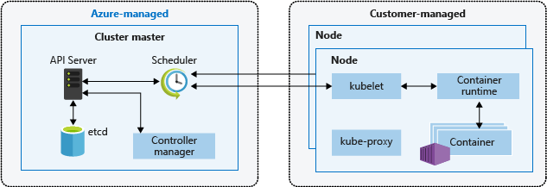
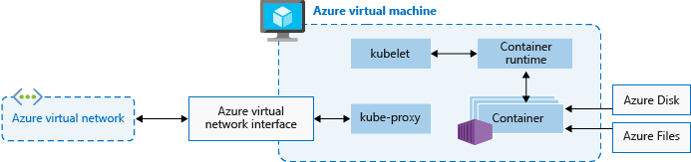
Kubernetes cluster architecture

Slide 21
Azure Kubernetes Service (AKS)
Azure Container Service (AKS)
Get started easily
$ az aks create -g myResourceGroup -n myCluster --generate-ssh-keys
\ Running ..
$ az aks install-cli
Downloading client to /usr/local/bin/kubectl ..
$ az aks get-credentials -g myResourceGroup -n myCluster
Merged "myCluster" as current context ..
$ kubectl get nodes
NAME STATUS AGE VERSION
aks-mycluster-36851231-0 Ready 4m v1.8.1
aks-mycluster-36851231-1 Ready 4m v1.8.1
aks-mycluster-36851231-2 Ready 4m v1.8.1

Slide 22
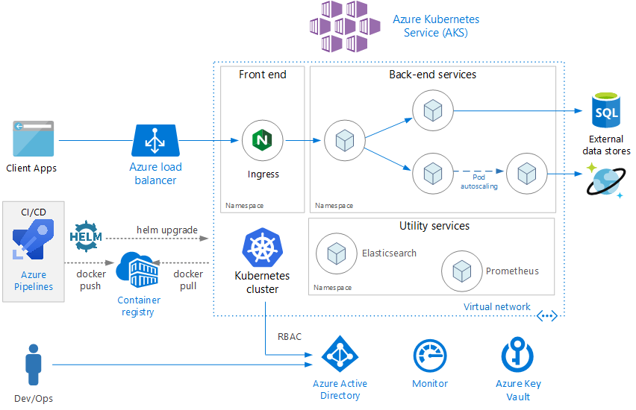
Microservices architecture on Azure Kubernetes Service (AKS)

Slide 23
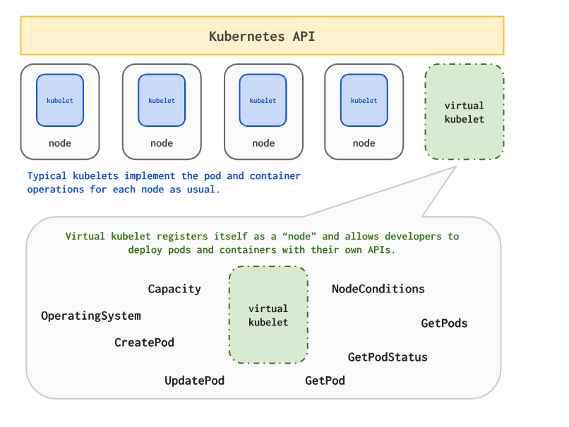

Virtual Kubelet
It allows Kubernetes Nodes to be backed by other services, such as serverless container platforms.
https://github.com/virtual-kubelet/virtual-kubelet

Slide 24
Bursting with the ACI Connector/ Virtual Kubelet
VM
VM
Pods
Pods
Azure Container Instances (ACI)
Application Architect
Pods
Kubernetes control pane
Infrastructure Architect
Deployment/tasks
ACI Connector
VM
VM
Pods
Pods

Slide 25



Azure Kubernetes Service (AKS)
App Service
Easily deploy and run container-based web apps at scale
App Service
Accelerated outer loop
Fully managed platform
Flexibility & choices
Azure Container Instances (ACI)
Tight integration w/ Docker Hub, Azure Container Registry
Automatic scaling and load balancing
From CLI, portal, or ARM template
Service Fabric
Built-in CI/CD w/ Deployment Slots
High availability w/ auto-patching
Single Docker image, multi container w/ Docker Compose
Azure Batch
Intelligent diagnostics & troubleshooting, remote debugging
Backup & recovery
IntelliJ, , Jenkin, Maven Visual Studio family
Azure Container Registry (ACR)

Slide 26
App Migration Options
Azure App Service
Lift and Shift
Containerize
Modernize
Deploy Code to App Service
Deploy Containers
Migration Tool

Slide 27
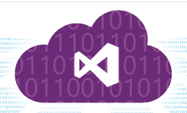

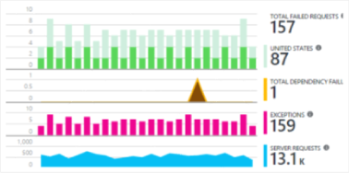


Developer Productivity
2) Code repository
3) Build
4) Deploy to stage
5) Validate
6) Publish
1) Develop
8) Monitor and improve
7) Deploy to cloud

Slide 28
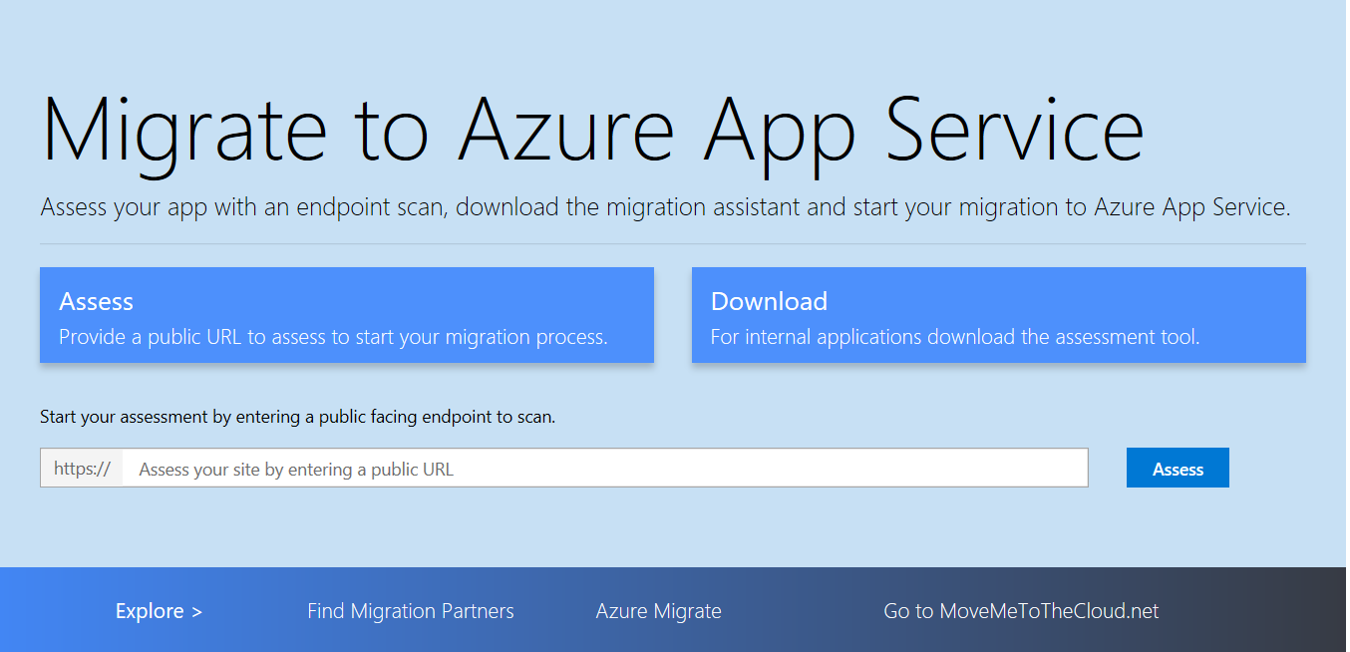
App Service Assessment Assistance
AKA.MS/APPMIGRATE

Slide 29
Azure App Service - Container Demo

Slide 30
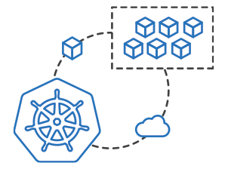
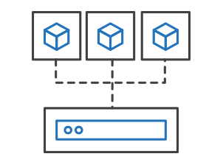
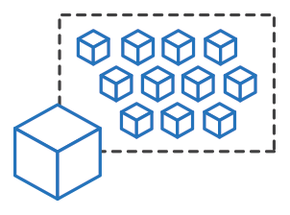
Azure Kubernetes Service (AKS)
Azure Container Instances (ACI)
Easily run containers on Azure without managing servers
App Service
Azure Container Instances (ACI)
Service Fabric
Run containers without managing servers
Increase agility with containers on demand
Secure applications with hypervisor isolation
Azure Batch
Azure Container Registry (ACR)

Slide 31
Azure Container Instances (ACI)
Get started easily
Azure Container Instances (ACI)
$ az container create --name mycontainer --image microsoft/aci-helloworld --resource-group myResourceGroup --ip-address public
"ipAddress": {
"ip": "52.168.86.133",
"ports": [...]
},
"location": "eastus",
"name": "mycontainer",
"osType": "Linux",
"provisioningState": "Succeeded",
$ curl 52.168.86.133
<html>
<head>
<title>Welcome to Azure Container Instances!</title>
</head>

Slide 32
Azure Container Instance - Demo

Slide 33

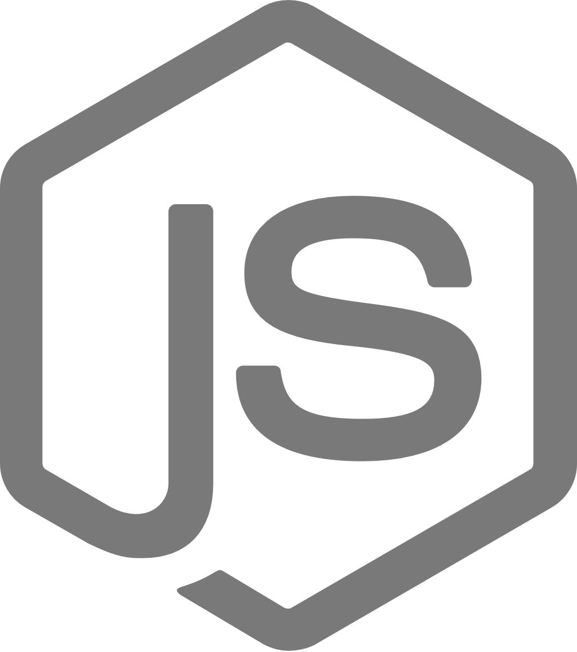
Azure Kubernetes Service (AKS)
Azure Service Fabric
A microservices platform for business critical applications
App Service
Build
Deploy
Operate
Azure Container Instances (ACI)
always-on, highly scalable microservice apps
</>
.NET
Service Fabric
</>
Azure Batch
Flexible infrastructure
Lifecycle management
24/7 availability & performance
Elastic scalability
Microservice and container orchestration
Security & compliance
Health & monitoring
Azure Container Registry (ACR)

Slide 34
Azure Kubernetes Service (AKS)
Azure Batch
Run repetitive compute jobs using containers
App Service
Azure Container Instances (ACI)
Enable applications and algorithms to easily and efficiently run in parallel at scale.
Run Batch tasks without having to manage an environment and dependencies.
Package, execute, and scale your High Performance Computing applications and batch workloads in a consistent, reproducible manner.
Service Fabric
Azure Batch
Azure Container Registry (ACR)

Slide 35
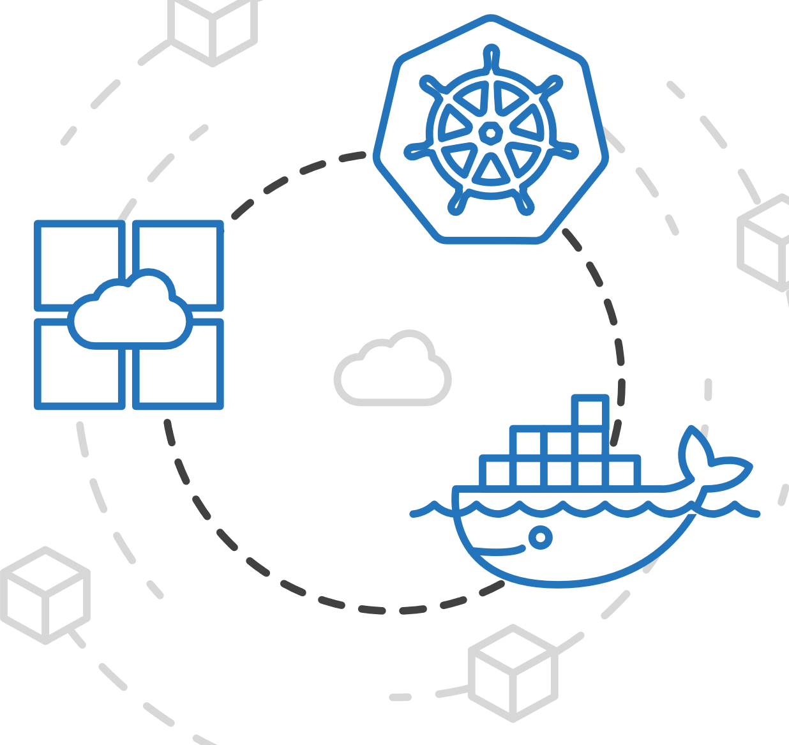
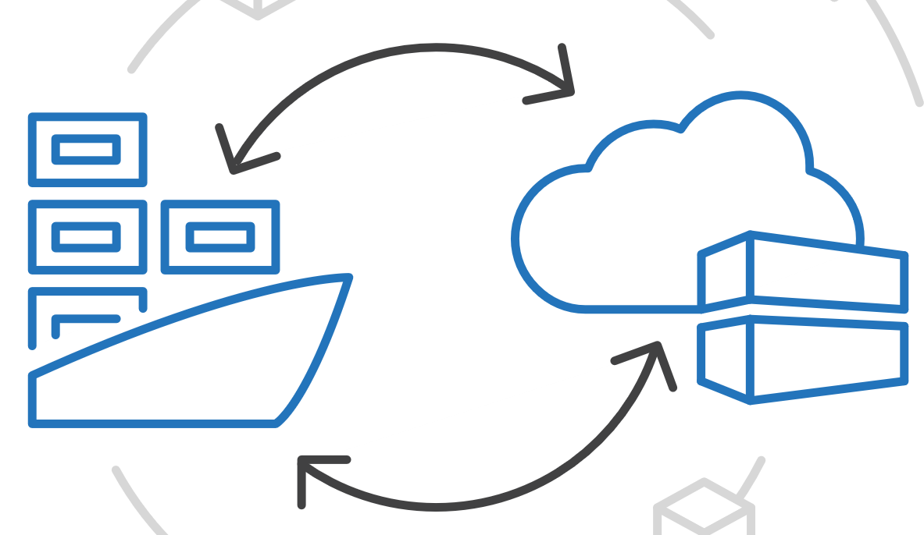
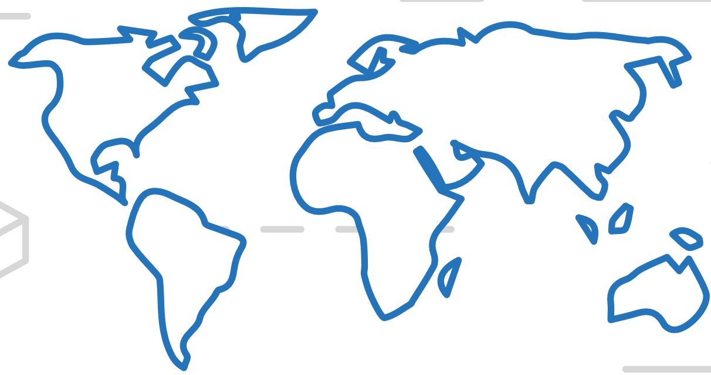
Azure Kubernetes Service (AKS)
Azure Container Registry (ACR)
Manage a Docker private registry as a first-class Azure resource
App Service
Azure Container Instances (ACI)
Service Fabric
Manage images for all types of containers
Use familiar, open-source Docker CLI tools
Azure Container Registry geo-replication
Azure Batch
Azure Container Registry (ACR)

Slide 36
Recap..
Containers in Azure
App Service
Service Fabric
Kubernetes Service
Container Instance
Ecosystem
Deploy web apps or APIs using containers in a PaaS environment
Modernize .NET applications to microservices using Windows Server containers
Scale and orchestrate Linux containers using Kubernetes
Elastically burst from your Azure Kubernetes Service (AKS) cluster
Bring your Partner solutions that run great on Azure
Azure Container Registry
Docker Hub
Choice of developer tools and clients

Slide 37

Azure container choice for Dev’s
Deploy web apps or APIs using Linux containers in a PaaS environment
Azure App Service
* Windows Container (Preview)
** Use Azure Container Instance for single container instance (ACI)
Scale and orchestrate Linux containers using Kubernetes
Azure Kubernetes Service (AKS)
Lift, shift and modernize .NET applications to microservices using Windows Server containers
Azure Service Fabric

Slide 38
Q & A
MahesKBlr

